Slide 1

JUST_HACK

Slide 2
ARTIFICIAL INTELLIGENCE and DATA SCIENCE
Team Members :
YOGESHWARAN
BALAMURUGAN
SRINATH
SATHIYA NARAYANAN
SANJAY

Slide 3


Slide 5
YES , OUR IDEA IS FINANCE PREDICTION WEBSITE

Slide 6
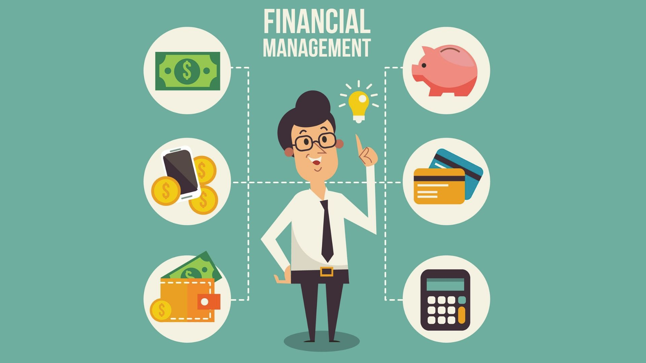
AI FINANCE BOT
About :
Our Website contains Daily finance news details, Finance Videos, online money Transfers,
Msg bot and it contains a AI BOT also…

Slide 7
YES! the question raised in your mind is right! how to calculate the physical transactions?...

Slide 8
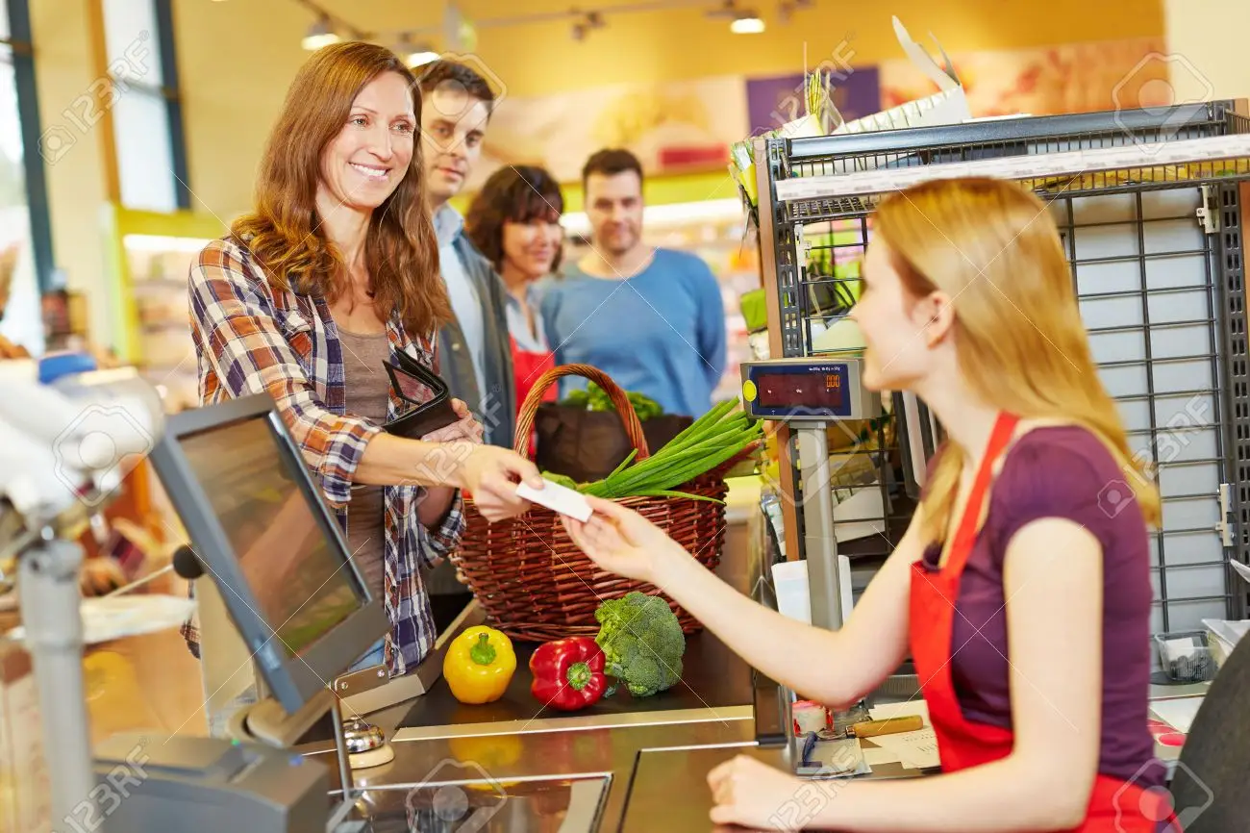
Bill scanning
we also have the solution for that for example :
If you are going to the super market and buy the lot of different things after that you just scan the bill using the AI FINANCE BOT it's analyse the text details and it make a different files for different things.. it's like a arrangement of books in library..All your details are Stored in the database…

Slide 9
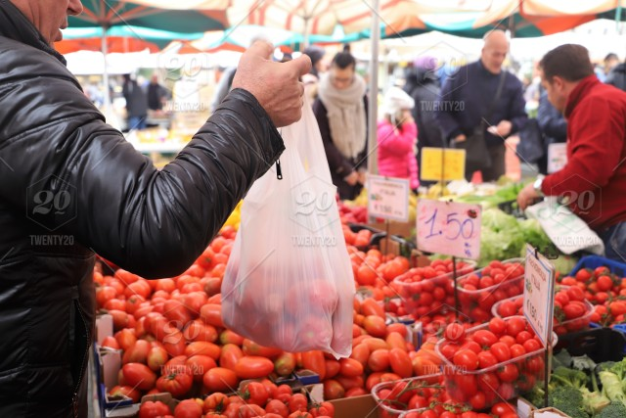
Example
if you want to buy a tomato this website will suggest
how many KG of tomato is needed for one month(using average of previous month datas)...

Slide 10
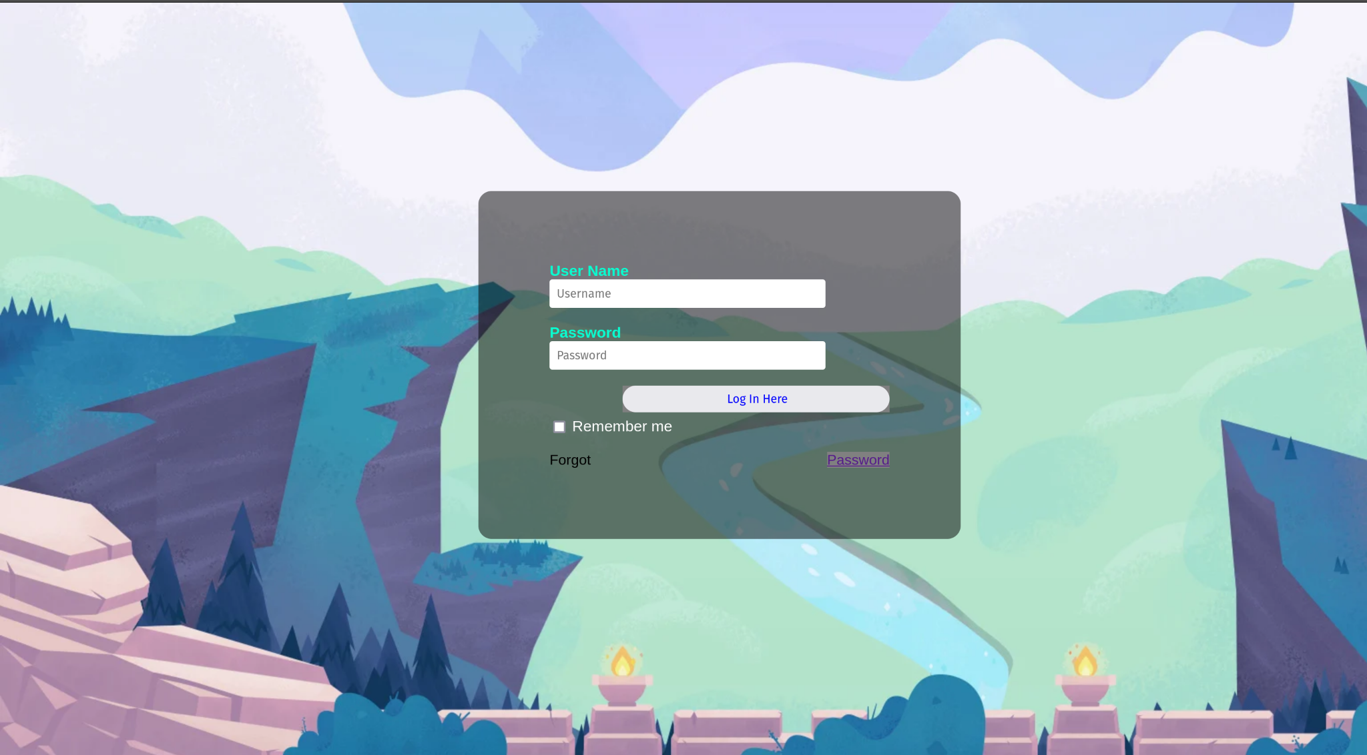
MODEL

Slide 11
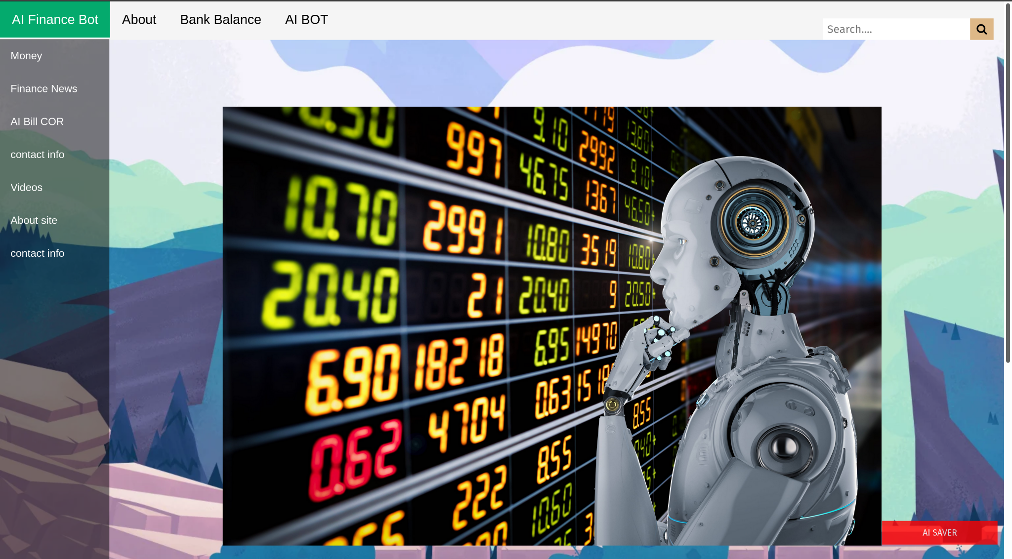

Slide 12
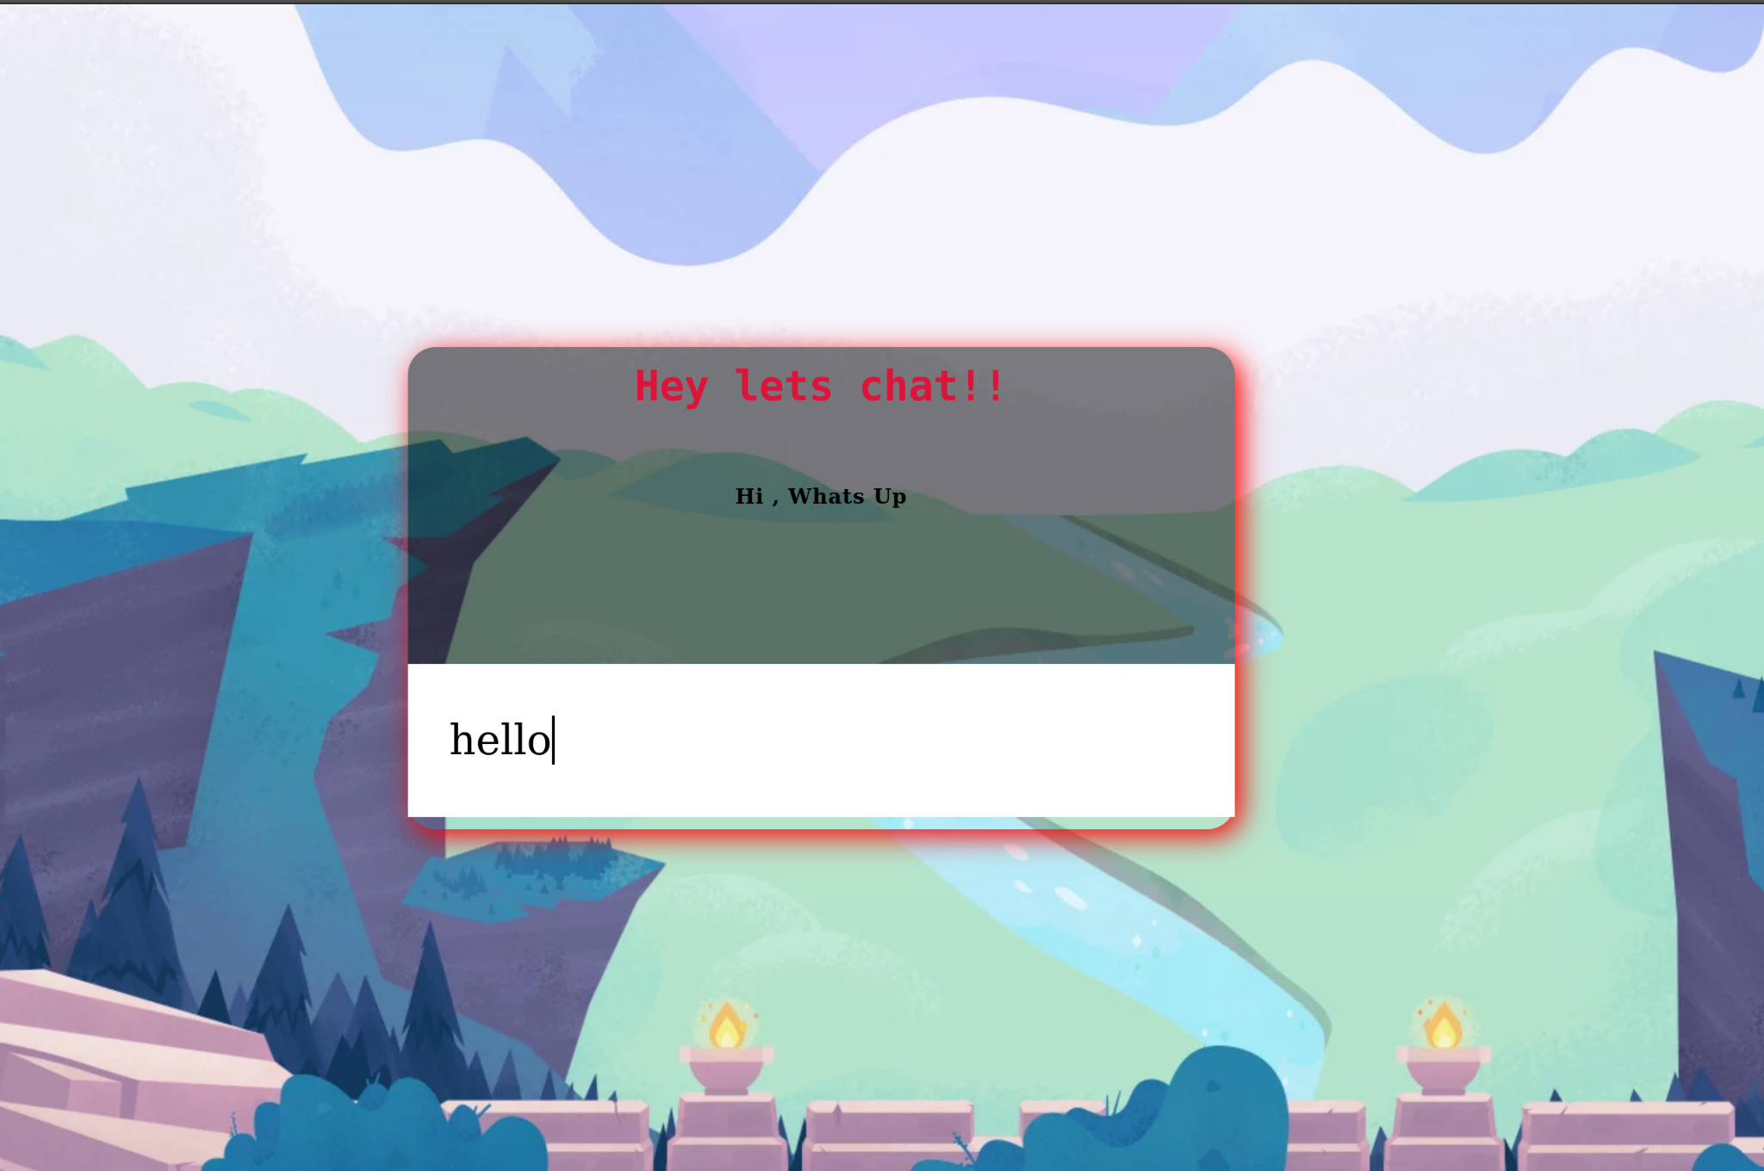

Slide 13


